Slide 1
ECG
Electrocardiogram: tracing of the Heart’s electrical activity
Helen Eftekhari
Arrhythmia Nurse Specialist
University Hospitals Coventry & Warwickshire
helen.eftekhari@uhcw.nhs.uk
024 7696 4794

Slide 2
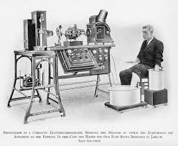
The complete electrocardiograph showing the manner in which the electrodes are attached to the patient: the hands and one foot being immersed in jars of salt solution
1842: Italian Matteucci associates electricity with heart beat
1895: William Einthoven credited for inventing ECG
1906: 1st diagnosis of arrhythmias
1924: Einthoven receives Nobel Prize
for ECG work
1938 AHA & Cardiac Society define chest leads

Slide 3
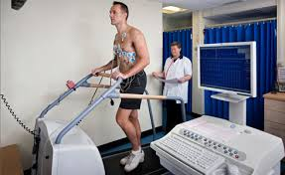
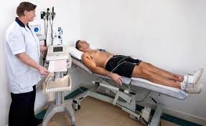
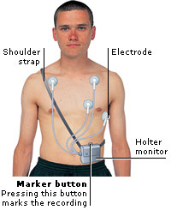
Modern ECG monitoring

Slide 4
Taking an ECG
Lay patient down - relax
Expose chest, wrists, ankles
Clean electrode sites (shave)
Apply 10 electrodes on total (single electrical contacts)
Attach wires correctly
Turn on machine : calibrate 10mm/mv
rate at 25mm/s
Record & print
Label tracing (name, DOB, hospital #, or NHS #)
reason for recording)
Compare to previous ECG’s

Slide 5
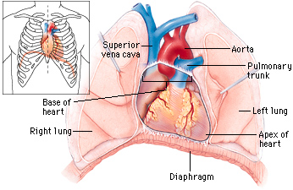
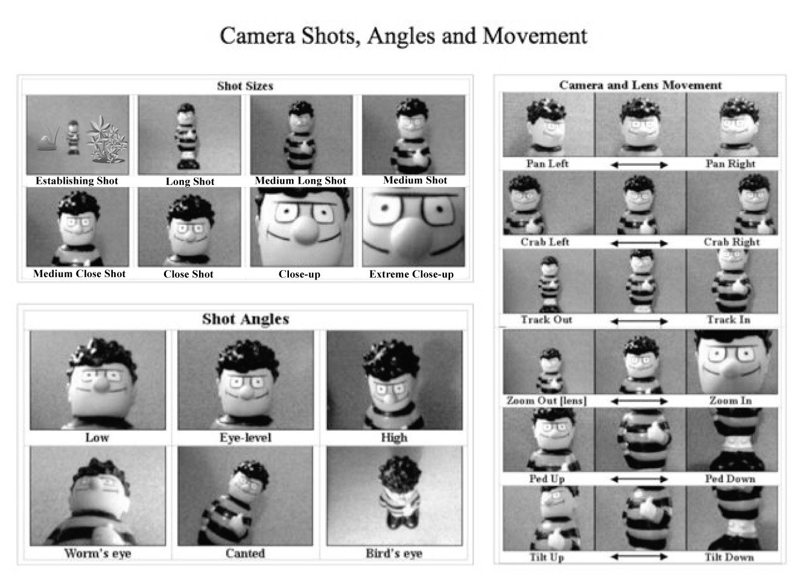
What is the ECG?

Slide 6
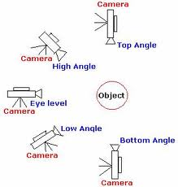
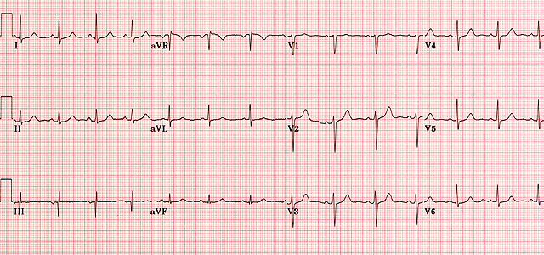
Normal ECG
ECG is the electrical recording of the cardiac cycle
There are distinct waveforms for each part of the cardiac cycle.
Studying the waveform identifies how the heart in beating & areas of damage.
Electrolyte disturbances, drug toxicity & more
DEPOLARIZATION
Contraction of any muscle is associated with electrical changes called depolaization
This is detected by the electrodes
Electrical impulse travels towards the electrode produce and upright “positive” deflection

Slide 7
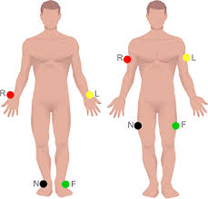
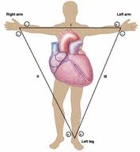
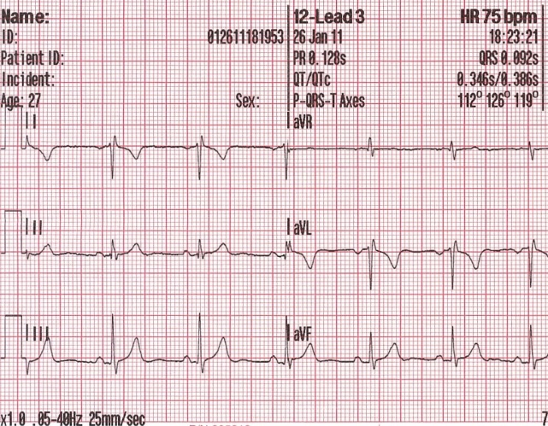
Electrode Placement
4 are limb electrodes
Right arm Ride
􀂃
Left arm Your
􀂃
Left leg Green
􀂃
Right leg Bike
Remember: The right leg electrode
is a neutral or “dummy” !
Einthovens Triangle
1st 6 views on the left side of ECG
(I, II, III, Avr, Avl, Avf)

Slide 8
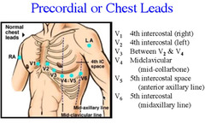
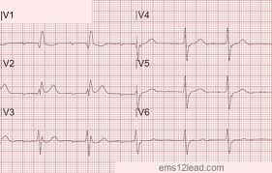
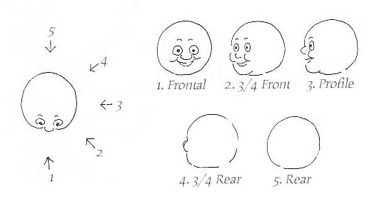
Precordial / chest leads placement
6 chest leads
V1 – V6
Views of the heart
V1 – V2 septum
V3-V4 Anterior surface
V5-V6 lateral
(limb leadsII,III & AvF inferior)

Slide 9
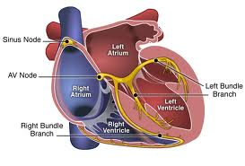
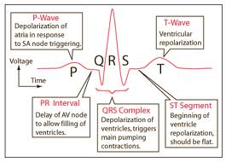
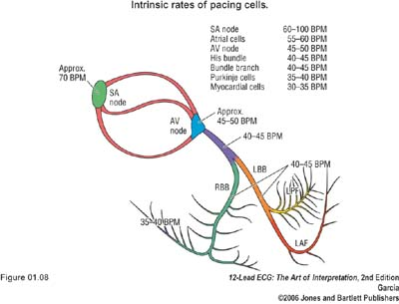
Heart conduction System

Slide 10
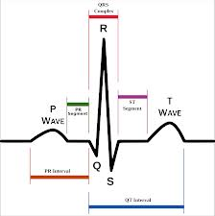
Elements of the trace
PR interval 120ms-200ms (3-5 small squares)
QRS below 120ms (3 small squares)

Slide 11
6 stage approach (ALS)
1 : Is there any electrical activity
2: what is the ventricular (QRS) rate
3. is the QRS rhythm regular or irregular
4. is the width of the QRS normal (narrow) or prolonged (broad)
5: is atrial activity present
6: is the atrial activity related to ventricular activity? If so how?

Slide 12
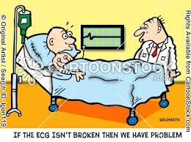
Is there electrical activity
Check electrode position
Check the patient

Slide 13
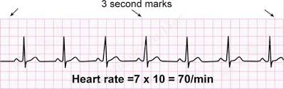

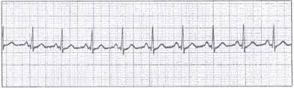
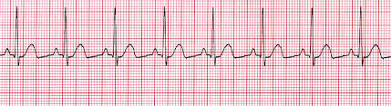
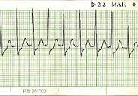
Heart Rate
What is the Ventricular (QRS ) rate?
Normal Heart rate 60-100 beats per minute
Slower than 60 beats per minute = Brady cardia
Faster than 100 beats per minute = Tachycardia
Calculate the heart rate
Standard ECG speed 25mms-1
1 second = 5 large square (25 small squares)
Heart rate = cardiac cycles in 6 seconds (30 large squares) x 10
(even when irregular good method)
Short rhythm strip? Cycles in 3 seconds (15 large squares ) x 20

Slide 14
6 stage approach (ALS)
1 : Is there any electrical activity
2: what is the ventricular (QRS) rate
3. is the QRS rhythm regular or irregular
4. is the width of the QRS normal (narrow) or prolonged (broad)
5: is atrial activity present
6: is the atrial activity related to ventricular activity? If so how?

Slide 15
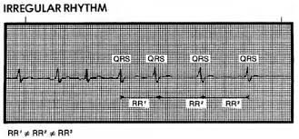


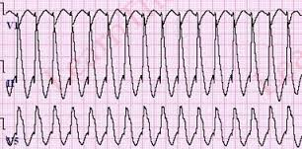
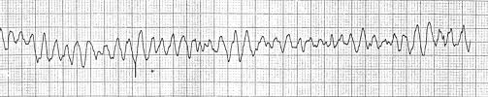
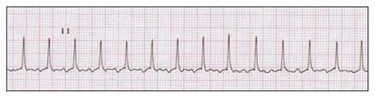
Rhythm
Is the QRS rhythm regular or irregular?
Not always obvious: difficult at high heart rates.
Requires an adequate length of rhythm strip
Mark R-R interval with strip of paper and compare
If irregular decide on
1) Totally irregular (irregularly irregular)? Atrial Fibrillation likely
2) Basically regular with intermittent irregularity (ie: extra beats / ectopics)
3) Cyclical variation in R-R interval?
(ie: after long pause escape beat)

Slide 16
6 stage approach (ALS)
1 : Is there any electrical activity
2: what is the ventricular (QRS) rate
3. is the QRS rhythm regular or irregular
4. is the width of the QRS normal (narrow) or prolonged (broad)
5: is atrial activity present
6: is the atrial activity related to ventricular activity? If so how?

Slide 17
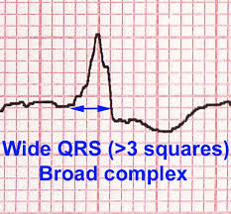
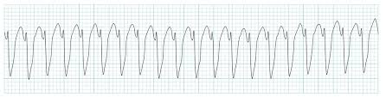
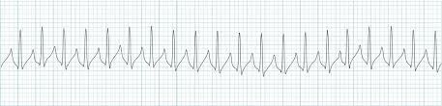
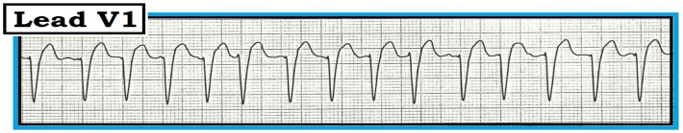
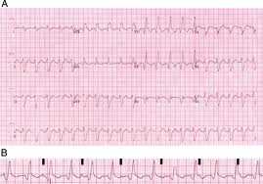
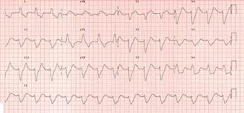
Is the QRS width Complex normal (narrow) or broad (prolonged)
QRS width is 0.12 seconds / 120 milliseconds / 3 small squares
If QRS less than 120 ms = narrow
If QRS greater than 120ms = broad

Slide 18
6 stage approach (ALS)
1 : Is there any electrical activity
2: what is the ventricular (QRS) rate
3. is the QRS rhythm regular or irregular
4. is the width of the QRS normal (narrow) or prolonged (broad)
5: is atrial activity present
6: is the atrial activity related to ventricular activity? If so how?

Slide 19

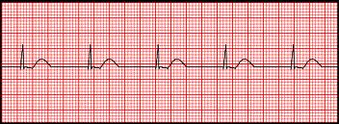
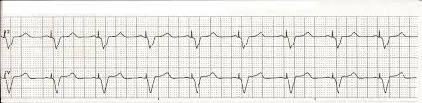
is atrial activity present ?
Not always present

Slide 20
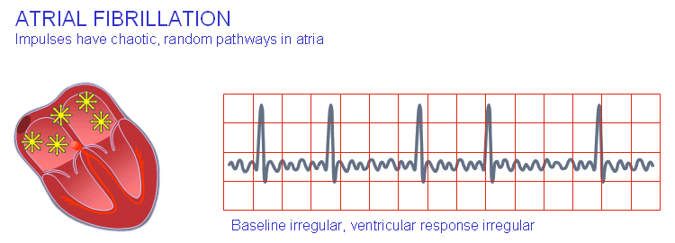
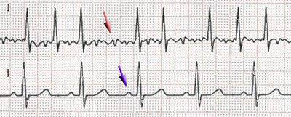
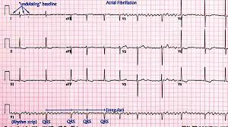
Atrial fibrillation

Slide 21
6 stage approach (ALS)
1 : Is there any electrical activity
2: what is the ventricular (QRS) rate
3. is the QRS rhythm regular or irregular
4. is the width of the QRS normal (narrow) or prolonged (broad)
5: is atrial activity present
6: is the atrial activity related to ventricular activity? If so how?

Slide 22

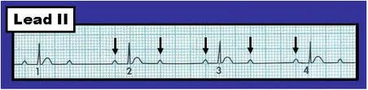

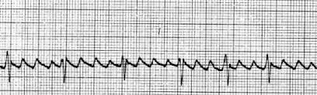
6: is the atrial activity related to ventricular activity? If so how?
Is there a consistent interval between each P wave and the following QRS?
Known as the P-R interval.
normal 120milliseconds – 200 ms
(or 3-5 small squares)
Depending on the P and QRS relation gives different types of heart block
1) 1st degree heart block is P-R interval greater than 200ms (5 small quares) & constant
2) If there is no relation or variation on above these are 2nd & 3rd degree heart block
Atrial Flutter
Flutter waves circulate the atria at rates of 300 – known as “saw-tooth”

Slide 23
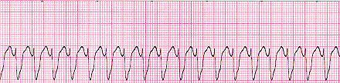
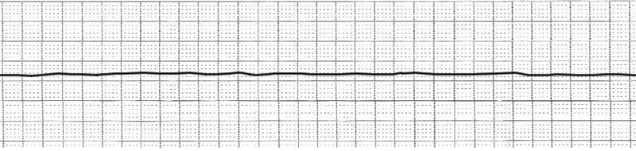
Dangerous Arrhythmias

Slide 24
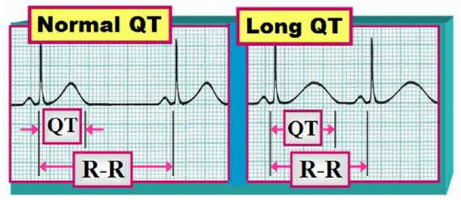
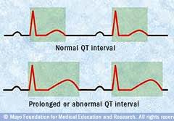
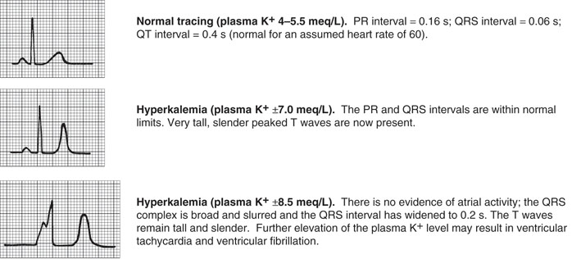
Distance between Q wave & end of T wave is known as QT interval
QT interval varies depending on age, gender, heart rate.
The faster the heart rate the shorter the QT interval.
Prolongation of QT interval predisposes to ventricular arrhythmias.
QT can be influenced by medications
QT prolonging drugs:
1)anti-depressants
2) anti-psychotics
3) Antibiotics
Long-list: www.sads.org/living-with-sads/drugs-to-avoid‎
Electrolyte disturbances

Slide 25
What do the following ECG’s show?

Slide 27
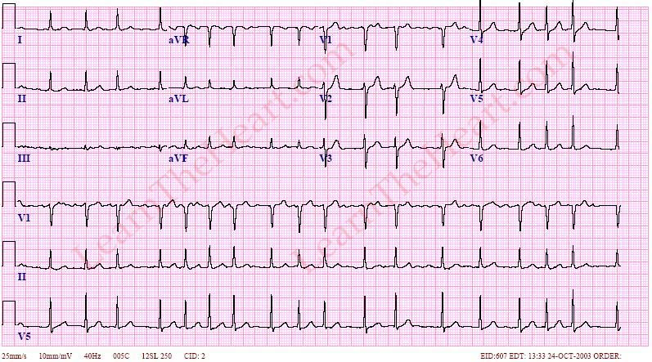

Slide 28
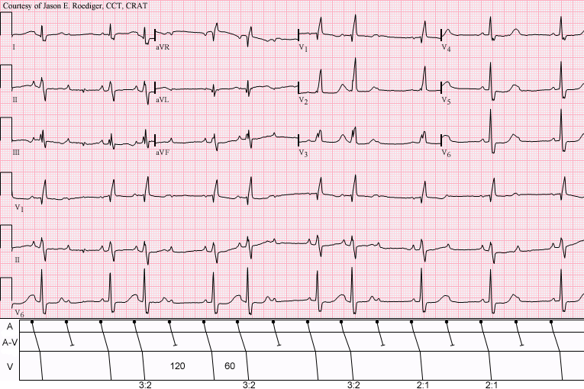

Slide 29
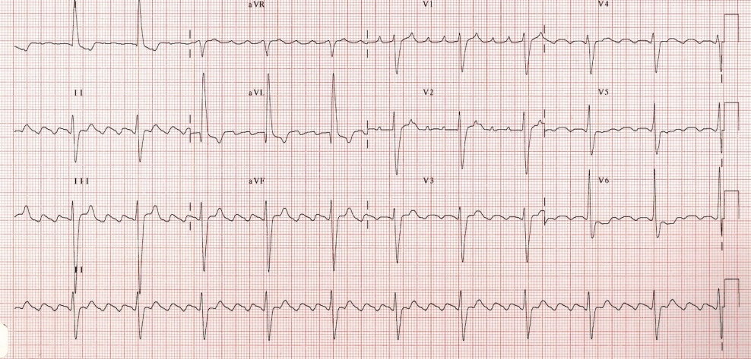

Slide 30
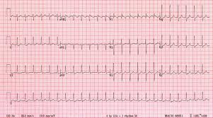

Slide 31
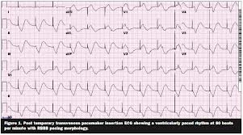

Slide 33


Slide 34


ST segment
Myocardial Infarction deprives the heart muscle of vital nutrients causing muscle damage: when this occurs the ability of the myocardial to relax (repolarise) is affected.

Slide 35


Slide 36


Slide 37


Slide 38


Slide 39


