Slide 1

Update on Arrhythmia Management
Angela Hall
Arrhythmia Nurse Specialist

Slide 2
Objectives
Overview of electrophysiology of the heart
Consider the range of arrhythmias
General management principles for narrow and broad complex arrhythmias
Update of pharmacological management

Slide 3
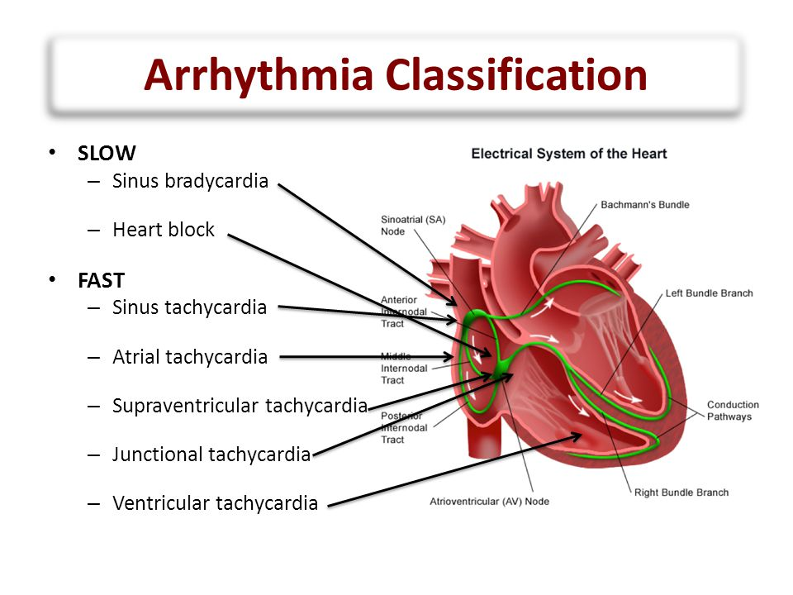
Notes:
Bachmann’s bundle – a branch off anterior intermodal tract in inner wall of left atrium. Part of the atrial conduction system. Part of the normal pathway of electrical conduction across to the left atrium.

Slide 4
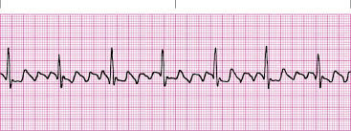
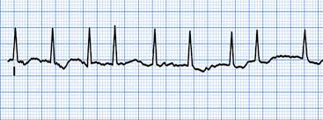
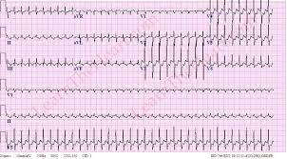
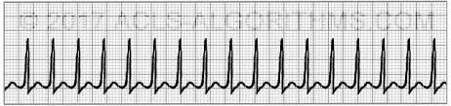
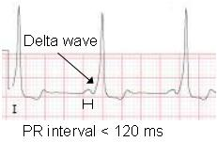
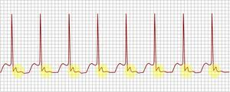
Narrow complex

Slide 5
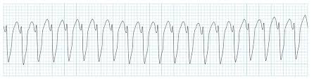
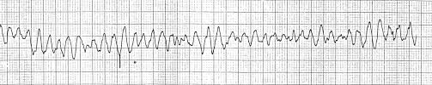
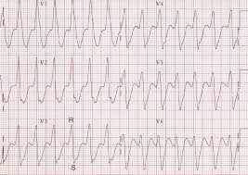
Broad complex
Or is it??
Notes:
Abberancy is when the supraventricular impulse travels down to the ventricles in a markedly different manner and appears broad in complexes

Slide 6
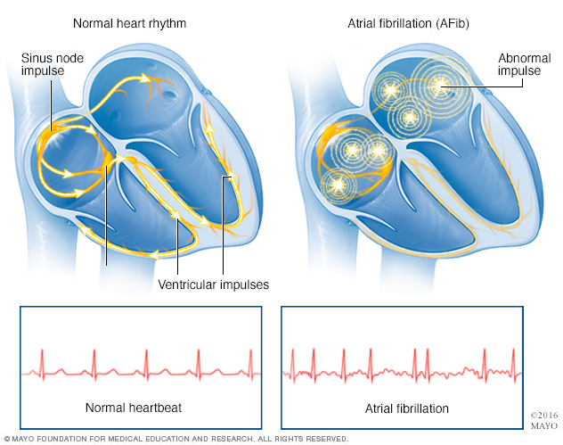
Atrial fibrillation

Slide 7
Investigations and clinical assessment including
risk stratification for stroke/thromboembolism
Paroxysmal
Rhythm control
Persistent
Rate or rhythm?
Permanent
Rate control
Confirmed diagnosis of AF
(or flutter)

Slide 8
Rhythm Rate
Try rhythm-control first for patients with persistent AF / flutter:
who are symptomatic
who are younger
presenting for the first time with lone AF
secondary to a treated or corrected precipitant
with congestive heart failure
Try rate-control first for patients with persistent AF / flutter:
asymptomatic
older (but not necessarily)
with contraindications to anti-arrhythmic drugs
unsuitable for cardioversion
previously unsuccessful attempts at rhythm correction or ERAF
General guidance
Use clinical judgement
Notes:
8
Unsuitable to CV – contraindications to anticoagulation, structural heart disease (eg enlarged LA >5.5cm, mitral stenosis) that precludes long term maintenance of SR; a long duration of AF (usually >12 months); history of multiple failed attempts at CV and / or relapses even with concomitant use of antiarrhythmic drugs or non-pharmacological approaches; an ongoing but reversible cause of AF (eg thyroid problems)
E.G now CV patients with moderate to severe heart failure and have some dramatic accounts of patients health improvements. Can be aggressive in management.
Rate control usually only if tried rhythm and unsuccessful, cannot tolerate AAD’s, elderly and asymptomatic

Slide 9
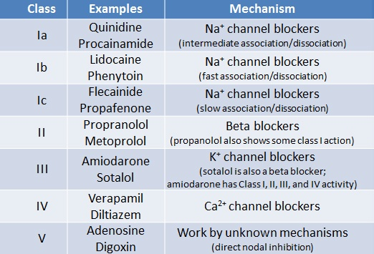

Slide 11
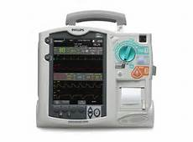
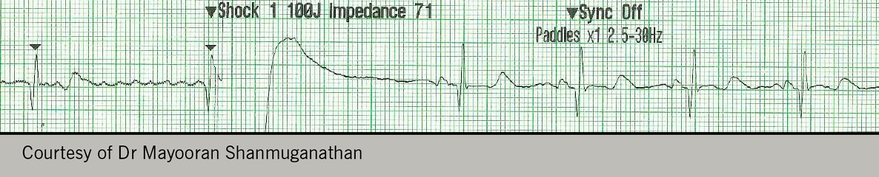
Cardioversion
AF < 48 hours onset – Clexane → CV (TOE), consider DOAC
AF > 48 hours onset – DOAC / Warfarin >3/52 (target INR)
CV 200J x 3 (paddles)
Continue anticoagulation 4/52 at least
Review after 1/12 – failure? – medicate / repeat CV with AAD’s, internal cardioversion, ablation…

Slide 12
CHA²DS²-VASc score
Risk Factor | Score
Congestive heart failure / LV dysfunction | 1
Hypertension | 1
Age ≥ 75 y | 2
Diabetes mellitus | 1
Stroke/TIA | 2
Vascular disease (prior myocardial infarction, peripheral artery disease or aortic plaque) | 1
Age 65-74 y | 1
Sex category (i.e. female gender) | 1
Lip GY, Nieuwlaat R, Pisters R, Lane DA, Crijns HJ (2010) Refining clinical risk stratification for predicting stroke and thromboembolism in atrial fibrillation using a novel risk factor-based approach: the euro heart survey on atrial fibrillation.
Chest. 2010 Feb;137(2):263-72.

Slide 13
Who should receive OAC?
ESC guidelines, updated (2016)
CHA2DS2-VASc Score
0 | No antithrombotic therapy
1 | OAC (VKA or NOAC) should be considered
≥ 2 | OAC (VKA or NOAC) is recommended
Notes:
13
13

Slide 14
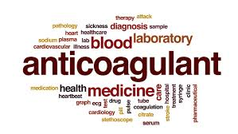
Anticoagulate
Warfarin
Apixaban
Dabigatran
Rivaroxaban
Assess stroke risk (CHA²DS²-VASc)
Assess bleeding risk
Risk vs benefit, clinical decision
Consider which oral anticoagulant
Patient choice
Patient education
Notes:
14
14
Bleeding risk factors – liver disease, concomitant drugs, elderly, very frequent falls, anaemia, high alcohol intake, renal disease, previous haemorrhage

Slide 15
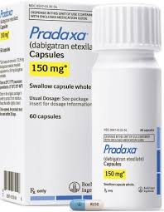
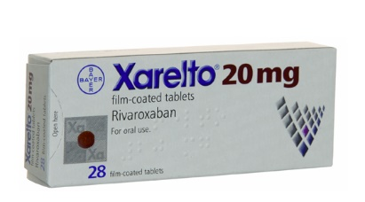
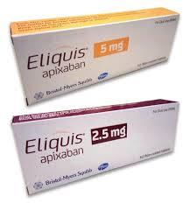
Direct anticoagulants (DOAC’s)
Dabigatran – (direct thrombin inhibitor)
Non-inferior to warfarin, caution with reduced renal function (CrCl <30ml/min), avoid in advanced liver disease (impaired baseline clotting)
Increased levels with Amiodarone and Verapamil
Half life 12-17 hours (bd preparation). Reversal agent now available
Rivaroxaban – (direct Xa inhibitor)
Non-inferior to warfarin, reduced dose with impaired renal function (CrCl 15-50ml/min)
Half life 5-9 hours (od preparation). No reversal (dialysis). Must eat with it
Apixaban - (direct Xa inhibitor)
Non inferior (or better) than warfarin, can still treat when renal function impaired
Blood levels increased with some antifungals / antibiotics. Less haemorrhagic risk
Half life 8-15 hours (bd preparation). No reversal (dialysis)
Notes:
Dabigatran – CrCl <15ml/min avoid
Caution with Amiodarone and Verpamail, St johns wort and rifampicin
Contraindicated with Ketoconozole, Quinidine
Rivaroxaban – 20mg bd or 15mg od if CrCl 15-49ml/min. Avoid if CrCl <15ml/min
DVT Tx – 15mg bd then 20mg after 3 weeks
Prophylaxis e.g. THR / TKR – 10mg od
Apixaban – levels increased with Ketoconazole / Clarithromycin by reducing the activity of liver enzymes that break down apixaban. Avoid with Phenytoin, st johns wort, rifampacin as blood levels reduced therefore reducing the effectiveness of the drug
DVT / PE Tx – 10mg bd for 7 days then 5mg bd. After 6/12 can reduce to 2.5mg od.
DVT post hip / knee – 2.5mg od starting 12-24 hours post op

Slide 16
SPAF trials versus Warfarin
 | Dabigatran | Rivaroxaban | Apixaban
Study | RE-LY | ROCKET-AF | ARISTOTLE
Design | Probe | Double blind | Double blind
Follow up | 2 years | 1.5 years | 1.5 years
Population size | >18,000 | >14,000 | >18,000
Inclusion | Non-valvular AF + 1 risk factor | Non-valvular AF + 2 risk factors | Non-valvular AF + 1 risk factor
Inclusion (CHADS) | 2.1 | 3.5 | 2.1
Primary endpoint | Stroke and systemic embolism | Stroke and systemic embolism | Stroke and systemic embolism
Warfarin comparator INR control (mean TTR) | 64% | 55% | 62%
Probe – prospective randomised open blinded endpoint

Slide 17
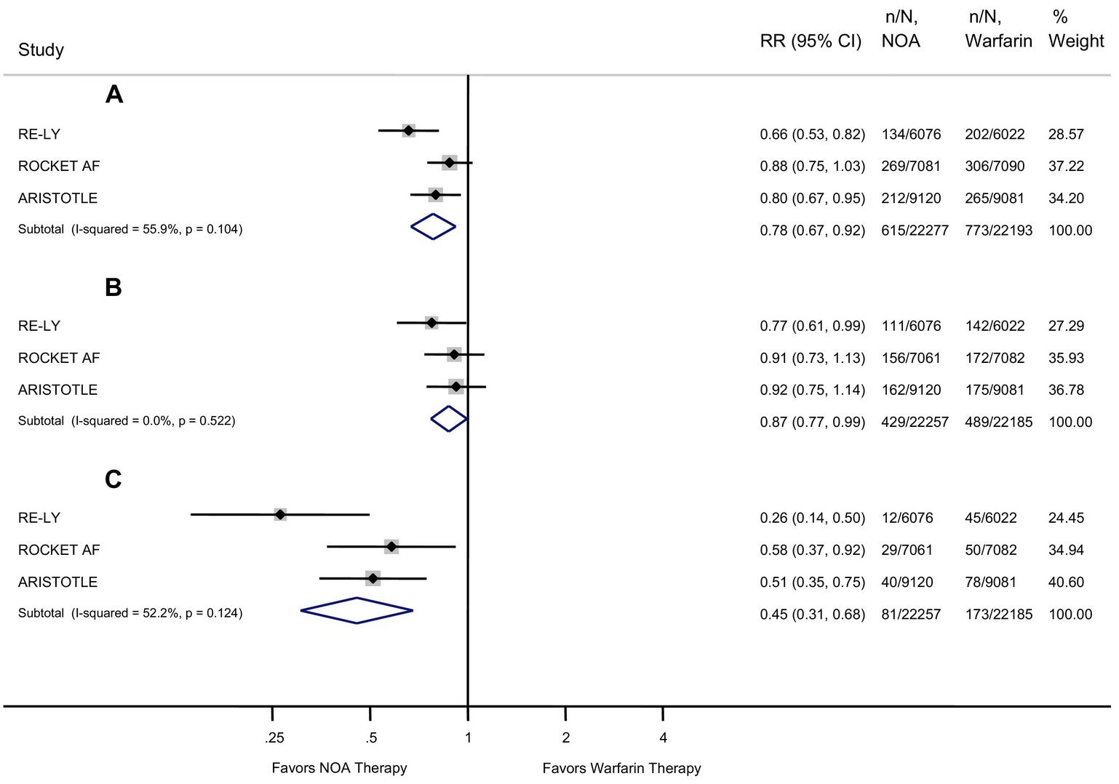
Efficacy and Safety of DOACs vs Warfarin
Major bleed
Stroke / embolism
ICH
Notes:
RE-LY (Dabigatran) – 110mg BD = to warfarin in stroke prevention but less bleeding than warfarin
150mg BD – more effective than warfarin in stroke prevention (1.1% per year vs 1.7%) with equivalent bleeding to warfarin. Less haemorrhagic stroke.
Rivaroxaban – less haemorrhagic stroke than warfarin, similar reduction in ischaemic stroke
Apixaban – less haemorrhagic stroke than warfarin, similar reduction in ischaemic stroke, less major bleeding than warfarin, lower overall mortality
Meta-analysis showed Apixaban as most preferential with lower major bleeding
Caution in obese

Slide 18
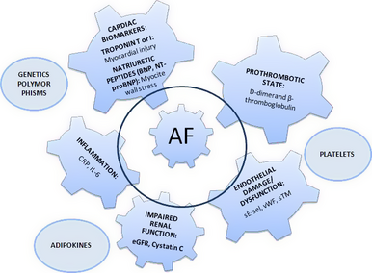
Troponin – I and T researched.
Troponin I particularly sensitive.
Strong association with stroke and
systemic embolic risk with rising trop.
Particularly useful when CHA2ds2-VASc
is one. Also helps identify those at truly
low risk (score of 0 and trop <3.3ng/L).
BNP – natriuretic peptide with
with diuretic and natriuretic properties.
Represents cardiac contractile
dysfunction. Produced in A and V.
A score of 0 but elevated BNP may
suggest treatment with OAC.
Strong correlation with AF type.
D-dimer – a detector of fibrin
formation. Main use is to exclude
thromboembolic disease.
Less contemporary
evidence but still of use.
Higher levels represent poorer
outcome and higher stroke risk.
Notes:
Natriuretic – excretion of sodium in urine via kidneys
BNP – secreted in response to excessive stretching of heart muscle cells, mostly from ventricles
NT-proBNP – biologically inactive

Slide 19
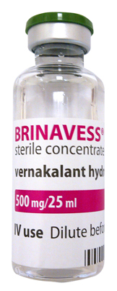
Vernakalant
Class I and III antiarrhythmic
Blocks sodium and potassium channels in all phases of the action potential (2)
Atrial-specific
Pharmacological cardioversion of recent onset AF
Post marketing use in AF < 48 hours duration
Half life 2-3 hours (5.5 hours in poor metabolisers)
Licensed for the rapid conversion of recent-onset AF to SR in adults who are non-surgery patients with AF ≤ 7 days duration or post-cardiac surgery patients with AF ≤ 3 days duration
Notes:
Vernakalant is the 1st of a new generation of AF converting agents that show preferential effects for atrial tissue and limited action on ventricular tissue.
Because of its relatively atrial-selective actions, vernakalant doesn’t readily fit in to the Vaughen-Williams antiarrhythmic drug classification, which is based on ventricular activity.
Late 2010 European Medicines Agency approved for EU, Iceland and Norway
In use across Europe and now Jersey

Slide 20
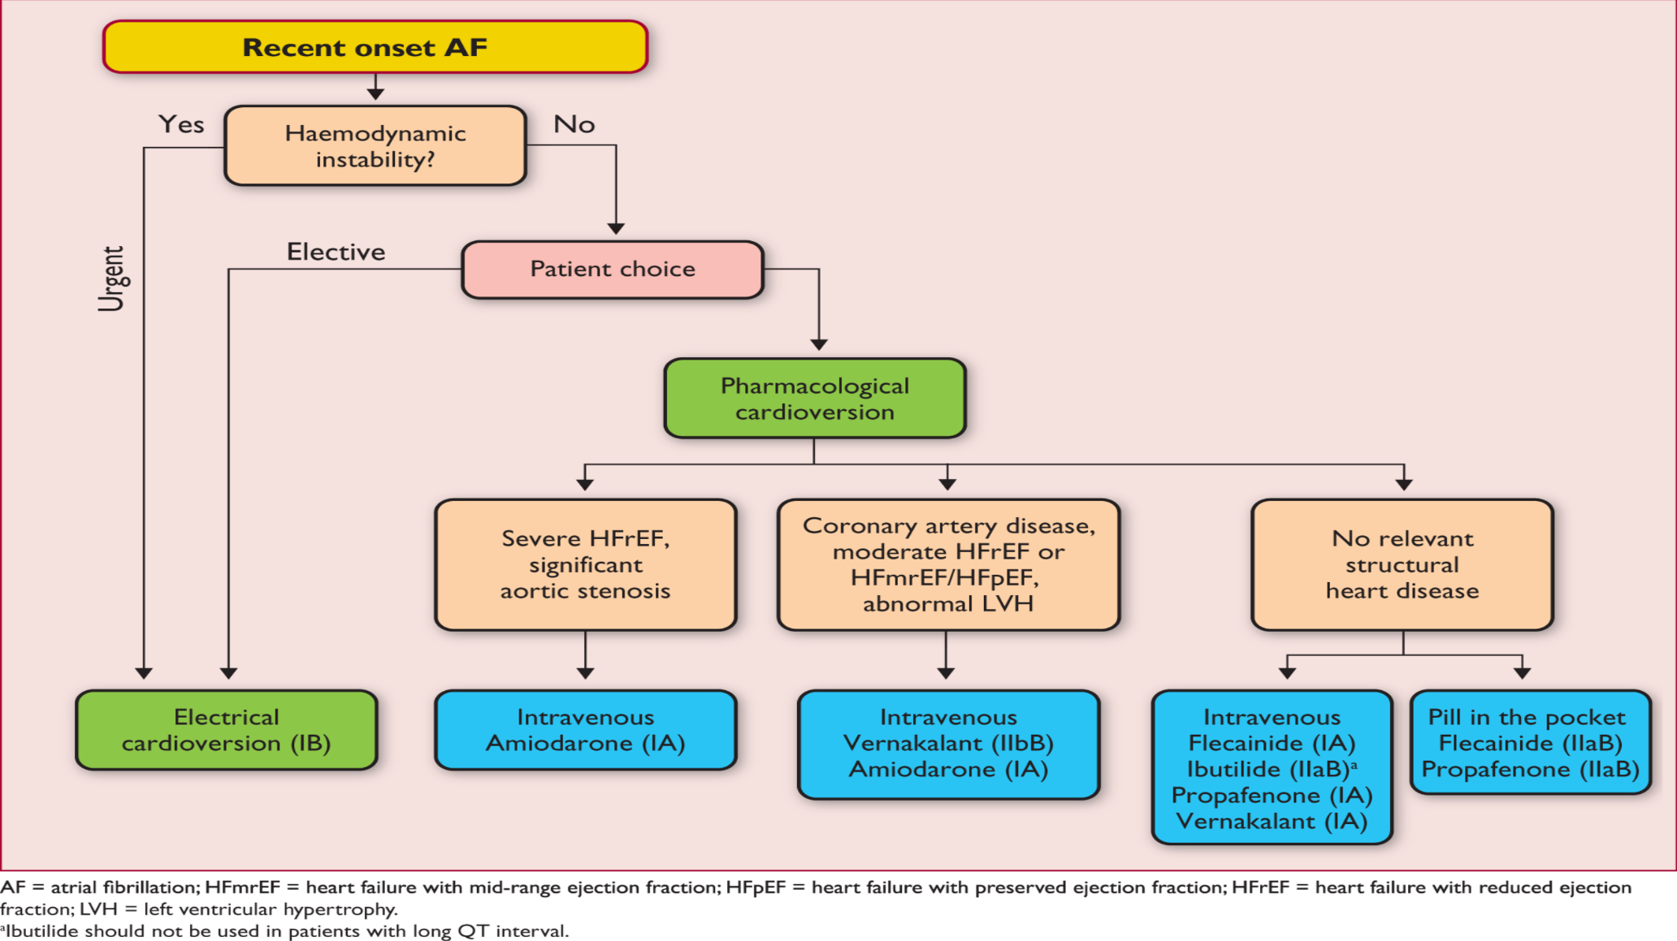
ESC 2016 AF guidelines
Notes:
IA recommendation in ECS guidelines for vernakalant to be given for cardioversion of new onset AF when the heart is structurally normal.
IIb B recommendation as an alternative to amiodarone when the heart is not entirely normal but in the absence of contraindications.

Slide 21

Action during AF
Normal
AF
Normal
AF
I_{TO}
I_{KUR}
ATRIUM
600-1000 BPM
I_{KR}
During Vernakalant infusion
I_{NA}
I_{ACH}
Shortened Refractory Period
Prolongation of Refractory Period
Late I_{NA}
I_{TO}
VENTRICLE
100-160 BPM
I_{KR}
During Vernakalant infusion
Minor prolongation of Refractory Period
(QRS & QT)
Notes:
Acts preferentially in the atria to prolong atrial refractoriness and to rate dependently slow impulse conduction.
Blocks currents in all phases of the action potential including potassium currents that are expressed specifically in the atria and involved in atrial repolarisation.
Secondary effect is drugs inhibition of sodium channels.
Very mild affect on QT – rapidly returns to baseline after infusion
Far less pro-arrhythmic effects
These anti-fibrillatory actions on refractoriness and conduction are thought to suppress re-entry and are potentiated in the atria during atrial fibrillation. Atrially refractoriness selectivity is thought to result from the block of currents that are expressed in the atria but not the ventricles as well as the unique electrophysiological condition of the fibrillating atria.

Slide 22
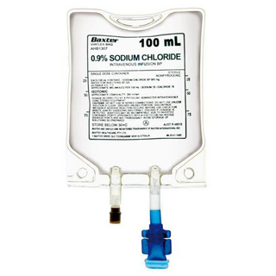
Administration
Dilute to a concentrate of 4mg/ml (0.9% sodium chloride or 5% glucose)
Dose calculated according to weight
≤100kg: 25ml of vernakalant 20mg/ml is added to 100ml of diluent
≥100kg: 30ml of vernakalant 20mg/ml is added to 120ml of diluent
1st infusion 3mg/kg over 10 minutes
Continue infusion until complete then stop 2nd infusion 2mg/kg over 10 minutes
Continue infusion until complete then stop Consider alternatives *
SR
AF or atrial flutter
SR
AF or atrial flutter
Notes:
No dose adjustment (age / renal function) 254kg patient success!
Max dose - ≥113kg the total dose is 339mg (84.7ml of 4mg/ml solution) over 10 minutes: the second infusion would not exceed 226mg (56.5ml) ‘’
Doses apply to weight 40-113kg
Other IV antiarrhythmics (class I or III) are contraindicated within 4 hours prior to and after Vernakalant administration
Resumption of initiation of oral antiarrhythmic therapy can be considered 2 hours after Vernakalant administration
Majority convert after the first dose (75-82%)
(Limited evidence of DCCV under 2 hours after infusion but can be considered)
CRAFT study – DC CV attempted within 24 hours in 3 patients – 100% success
ACT III - 7 developed flutter with all successfully cardioverted
AVRO - all who developed flutter within 4 hours post dose were cardioverted successfully
Vernakalant did not affect efficacy of electrical cardioversion

Slide 23
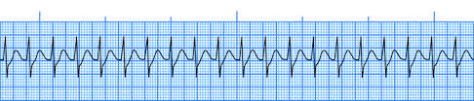
Narrow complex tachycardia (SVT)
Recommendations - Acute treatment
Vagal manoeuvers
Adenosine for acute treatment in patients with regular SVT
Synchronised cardioversion for acute treatment when hemodynamically unstable SVT when vagal manoeuvers or adenosine are ineffective
Synchronised cardioversion for acute treatment with hemodynamically stable SVT when pharmacological therapy is ineffective or contraindicated
Intravenous diltiazem, verapamil or beta blockers can be effective acutely or longterm
(2015 ACC/AHA/HRS Guideline for the Management of SVT)

Slide 24
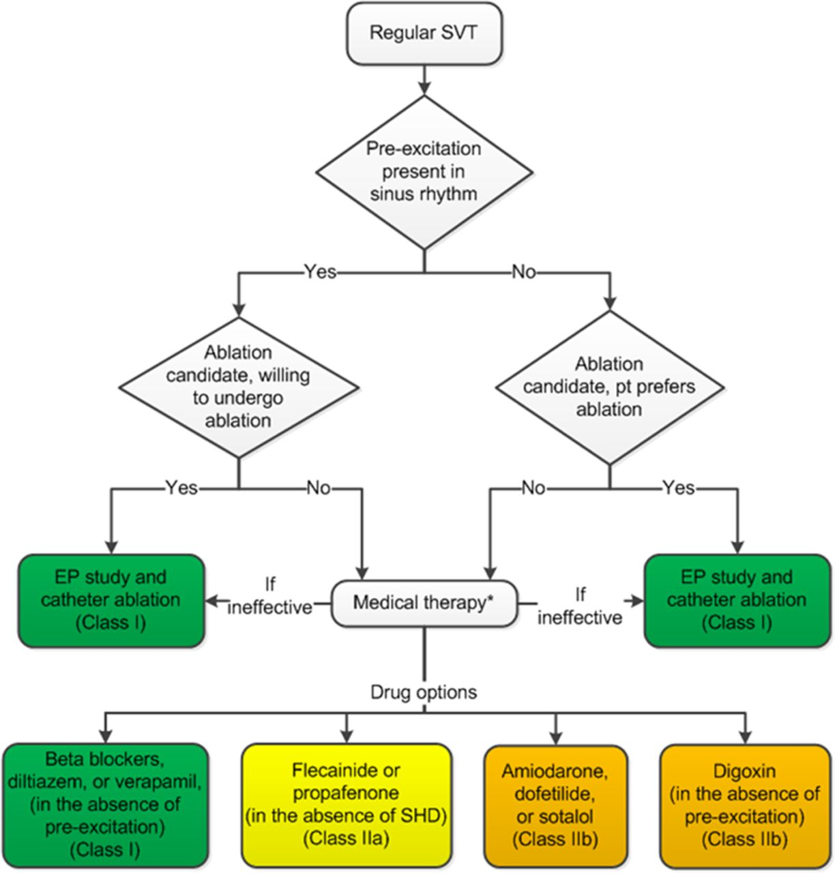
Ongoing management
Ia Betablocker, Diltiazem or Verapamil
Ia EP study +/- ablation
Ia Vagal manoeuvres
IIa Flecainide
IIb Sotalol
IIb Amiodarone

Slide 25
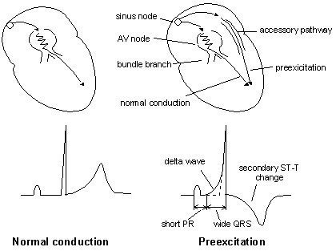
Pre-excitation (e.g. WPW)
Acutely
Adenosine, Verapamil, Metoprolol
Longer term
Ablation
Notes:
Pre-excitation refers to early activation of the ventricles due to impulses bypassing the AV node via an accessory pathway.
Accessory pathways, also known as bypass tracts, are abnormal conduction pathways formed during cardiac development and can exist in a variety of anatomical locations and in some patients there may be multiple pathways
An accessory pathway can conduct impulses either anterograde, towards the ventricle, retrograde, away from the ventricle, or in both directions
AF and WPW- no AV nodal blocking drugs as can increase AV conduction without being slowed at the AV node

Slide 26
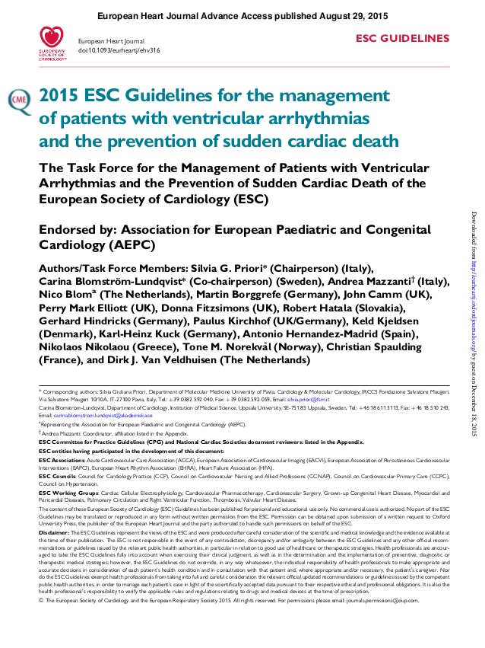
Ventricular arrhythmias
Acutely – pulseless VT / VF – defibrillation / ALS
Beta blockers
Amiodarone
Anti-arrhythmics – pro-arrhythmic, prolong QT - caution
Consider device therapy
Ablation
(2015 ESC Guidelines for the management of patients with ventricular arrhythmias)
Specialist advice
Notes:
BB’s only shown to be effective in primary management of VA’s in RCT’s. CCBs less so.
Amiodarone has some effectiveness
All pro-arrhythmic and cautious use

Slide 27
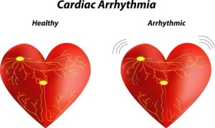
Angela Hall
Kellyanne Kinsella
#121
#311
Summary
How is the patient?
Broad complex or narrow complex
Call for help
Specialist input
If AF / flutter consider stroke risk
Rate control

